Slide 1

Analysis of Crypto
Currency Growth In
last 9 years
- Harsh Kumar Sulya

Slide 2

PROBLEM STATEMENT
Over the past nine years, cryptocurrency has evolved into a disruptive force in finance, yet it faces significant challenges. Volatility remains a persistent issue, hindering mainstream adoption and stability. Regulatory uncertainty adds further complexity, with governments worldwide struggling to establish clear guidelines. Security concerns persist, as exchanges and wallets remain vulnerable to hacking.

Slide 3
Project Description
This project aims to conduct a comprehensive analysis of cryptocurrency trends, market dynamics, technological advancements, regulatory frameworks, and adoption patterns from 2015 to 2024. Through data collection, statistical analysis, and qualitative assessments, the project will explore the factors driving cryptocurrency's growth, assess its impact on traditional financial systems, and examine challenges such as security, scalability, and regulatory uncertainty. By synthesizing historical data and current trends, this analysis seeks to provide valuable insights into the past, present, and future of cryptocurrencies, informing stakeholders, policymakers, and investors alike."

Slide 4

WHO ARE THE END USERS?
Investors and Traders: Individuals and institutions involved in buying, selling, and trading cryptocurrencies who seek insights to make informed investment decisions.
Policy Makers and Regulators: Government officials, lawmakers, and regulatory bodies interested in understanding the impact of cryptocurrency on financial systems and crafting appropriate regulatory frameworks.
Researchers and Academics: Scholars and researchers studying the cryptocurrency space who can benefit from the analysis to deepen their understanding and contribute to academic discourse.
Cryptocurrency Developers and Technologists: Professionals involved in developing blockchain technologies and cryptocurrency platforms who can use insights to guide their innovation efforts.

Slide 5

Technology Used
The project will leverage Power BI for data visualization and analysis due to its robust features for handling large datasets and creating interactive dashboards. Additionally, the project may utilize programming languages like Python or R for data preprocessing and statistical analysis, along with SQL for data querying and manipulation if necessary. Historical cryptocurrency data can be sourced from various exchanges and market data providers such as CoinMarketCap, CryptoCompare, or directly from blockchain explorers. Integration with cloud services like Azure may also be considered for data storage and processing, ensuring scalability and reliability.

Slide 6
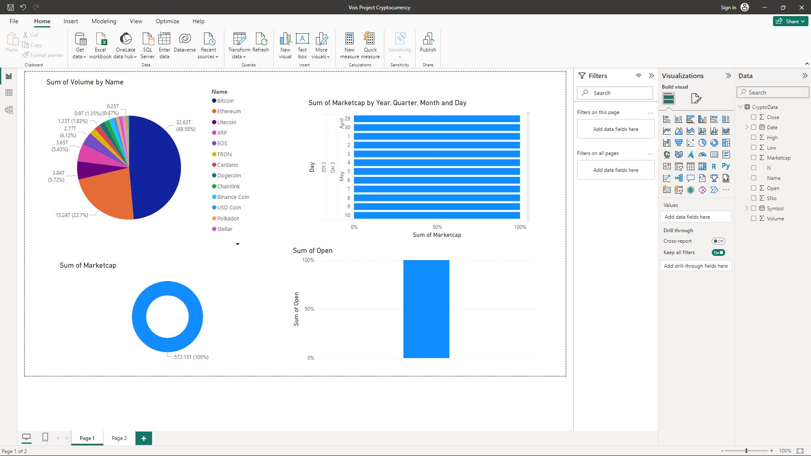
RESULTS
Output :

Slide 7
Thank you
.
.

